Slide 1

In extension to Case Study 1
from
Machine Learning and Data Science Blueprints for
finance by Tatsat Chapter 5
Pai Peng 1002725394
Liyan Liu 1002896100
Fulin Huang 1002942756
Shixiong Gao 1007038260

Slide 2
Summary
Our project is an extension to Case 1 from Machine Learning and Data Science Blueprints for finance Tatsat Chapter 5. Our task is to perform stock price prediction on Microsoft’s dataset.
To get started, we use the seed program from here
Correlated dataset(currency, market index and stock price data from 2011.1.1-2019.1.1) and other associated data are provided in the project folder. All data are uploaded to Google Colab before running the code.
Our improvements include:
Adding more features: Technical Indicators, Dix, Gex, Smoothing features etc…
Introducing model selection algorithm: PCA
Adding more machine learning models: XGBoost
Adding grid-search to the LSTM model tuning
Using financial metrics, such as CAGR, Sharpe Ratio, maxDD, etc…
Plotting train and test equity curves to visualize performance
Final White Reality Check for the system

Slide 3
PART 01
Original Program Overview

Slide 4
An overview to the original program
The target is to predict Microsoft stock price change (weekly) with supervised machine learning methods.
Inputs/predictors used are potentially correlated assets from 3 groups:
Stocks: IBM, GOOGLE
Currency: USD/JPY, GBP/USD
Indices: S&P500, Dow Jones, Vix
These inputs are then processed to get their weekly log-price change. 5-days, 15-days, 30-days lagged returns of Microsoft are also included.
Multiple dimensions of the dataset are investigated. Including spread, correlations, time-series analysis.
Then proceeding to model evaluation. Models being considered are:
Regression Models and Tree: Linear regression, Lasso regression, ElasticNet, KNN, decision tree, SVR and ARIMA
Ensemble Models: Ada boost, Gradient boost, Random forest and Extra tree regressor
Deep Learning: MLP, LSTM

Slide 5
PART 02
Issues with the original program

Slide 6
Issues with the original program
Issue with Predictors
The number of predictors is fairly small, and the limited features selected by the original program may not perform well on explaining the variations of Microsoft’s stock price.
The predicted power could be enhanced by adding more relevant features.
Issue with Data Preparation
Feature reduction is discarded by the original program due to the relatively small number of variables considered.
Using SelectKBest function in Scikit-learn may not be an optimal method to select k best features. It uses univariate linear regression tests returning F-statistics to see whether there is any statistically significant relationship between them. Therefore, univariate models are unable to show relationships between different predictors. Correlations or inversions cannot be modelled using this method.
We could try using PCA to implement dimension reduction as more features are added, it will give us a more comprehensive analysis on the data.

Slide 7
Issues with the original program
Issue with Model Selection
The criteria of model selection is ambiguous and less convincing. In the original program, hyperparameters of ARIMA and LSTM models are randomly selected, and it chooses ARIMA model by only looking at the test error
A more precise criterion of model selection should be performed, for example, involving cross-validation on the training set
More models could be considered as candidates, for example XGBoost
Issue with Algorithm Evaluation
Simply checking the MSE of final model on test set is insufficient
Lower error does not necessarily mean better algorithm
More evaluation metrics could be involved, such as CAGR and Sharpe Ratio
We should also consider the likelihood that positive results were obtained strictly due to the chosen system

Slide 8
PART 03
Our Extended Program

Slide 9
Data Source
Stocks: IBM, GOOGLE, MICROSOFT from Yahoo Finance
Currency: USD/JPY, GBP/USD from FRED website
Indices: S&P500, Dow Jones, Vix, from FRED website and Dix & Gex of S&P500 from professor’s resources
Target: Weekly Log price change of MICROSOFT
Note: all daily data are processed to weekly data from 2011.01.01 to 2019.01.01

Slide 10
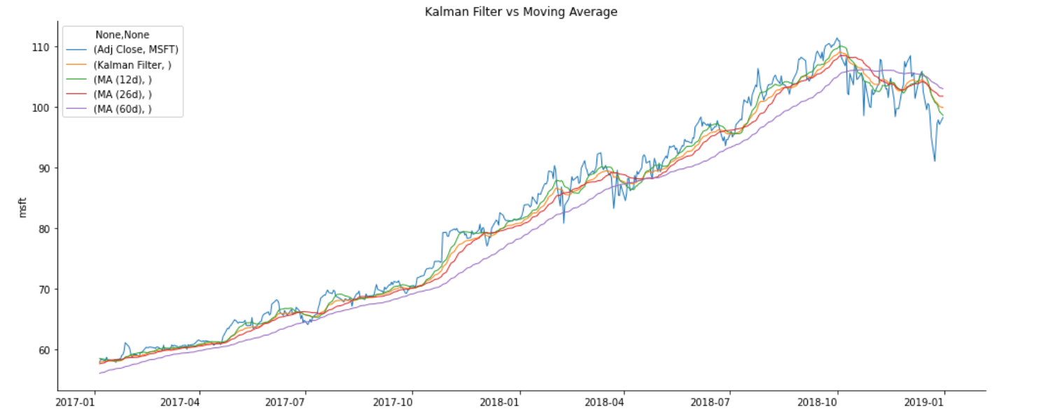
More Predictors
Adding Smoothing Feature
We compare Kalman Filter with Moving Average as figure shown below, and we learn that “Kalman Filter is a more accurate smoothing/prediction algorithm than the moving average because it is adaptive: it accounts for estimation errors and tries to adjust its predictions from the information it learned in the previous stage.” ¹
Therefore we take Kalman Filter as one of predictors for Microsoft Stock Price.
1 https://help.cqg.com/cqgic/20/default.htm#!Documents/kalmanfilter.html

Slide 11
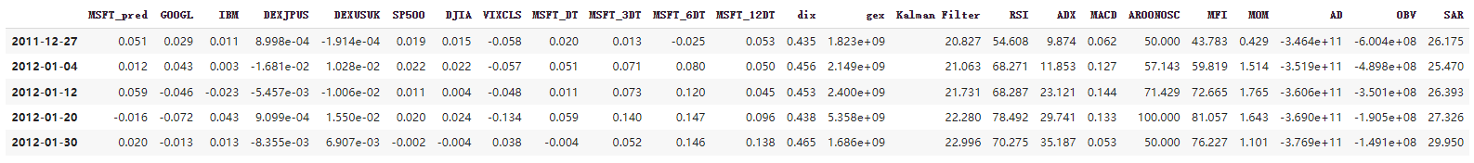
More Predictors
Adding Technical Indicators
We add more predictors using Ta-lib library, and they are computed based on close price, highest/low price, volume of Microsoft data.
Technical indicators including RSI, ADX, MACD, Aroon Oscillator, Money Flow Indicator, Momentum, accumulation/distribution indicator, On-balance volume, and SAR.
Among them, Momentum，RSI show greater correlation with the Microsoft’ stock Price using SelectKBest method from original program
Adding Dix and Gex
Using The Dark Index and Gamma Exposure index of S&P500 (provided by professor) as additional predictors for Microsoft Stock Price.
The first 5 lines of dataset after including all new variables are shown below

Slide 12
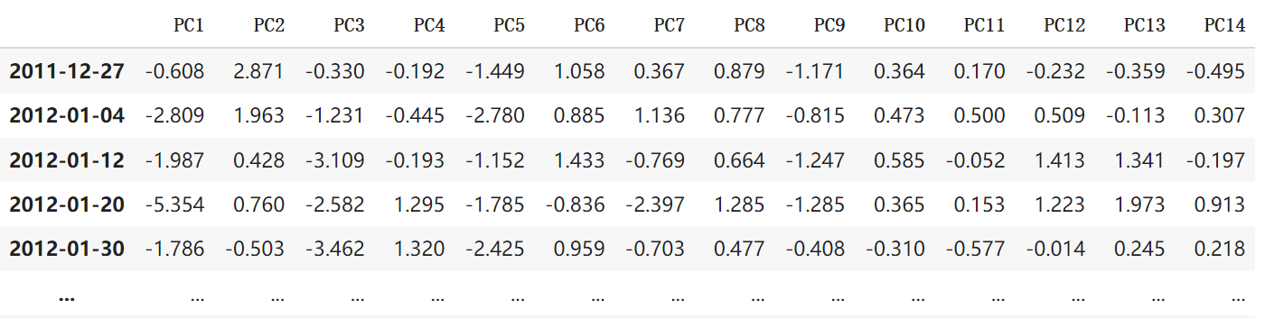
Dimension Reduction
Principle Component Analysis
Since we add more predictors in the dataset, there’re 23 predictors in total.
In order to reduce the dimensionality of this large dataset, we decide to use PCA to remove unnecessary component, while keeping variance at 95% level.
We perform train-test split before operate PCA, making size of test set equals 20% dataset
PCA requires standardization since it is sensitive to the scale of inputs. Standardization is calculated on training set and later apply to the test set, in order to prevent using any information coming from the test set before or during training, which is a potential bias in the evaluation of the performance.
The first 14 Principle Components explain 95% variance of the data.
The results are shown below：

Slide 13
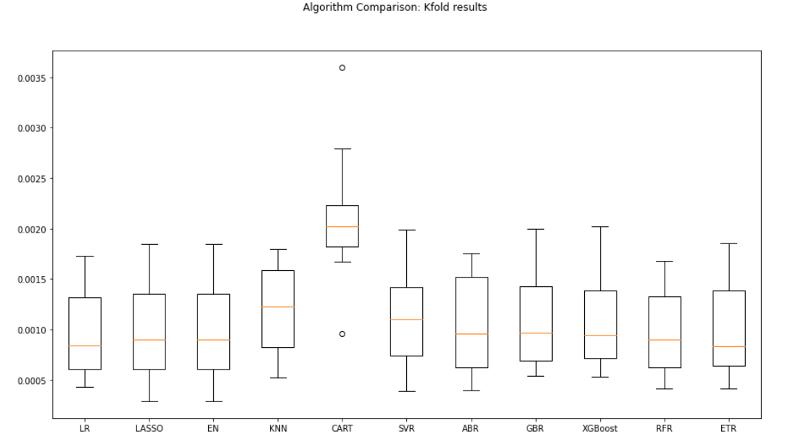
Add machine learning model – XGBoost
XGBoost is a boosting ensemble method that has high performance, good accuracy, and highly scalable.
XGBoost is added as a supervised regression model to train and predict the data.
Default tunning parameters are used in the XGBoost Regressor.
The cross validation results are shown below
From the box plot of kfold results, we observe that the XGBoost Regressor model has a comparable result as LR, LASSO and ETR.

Slide 14
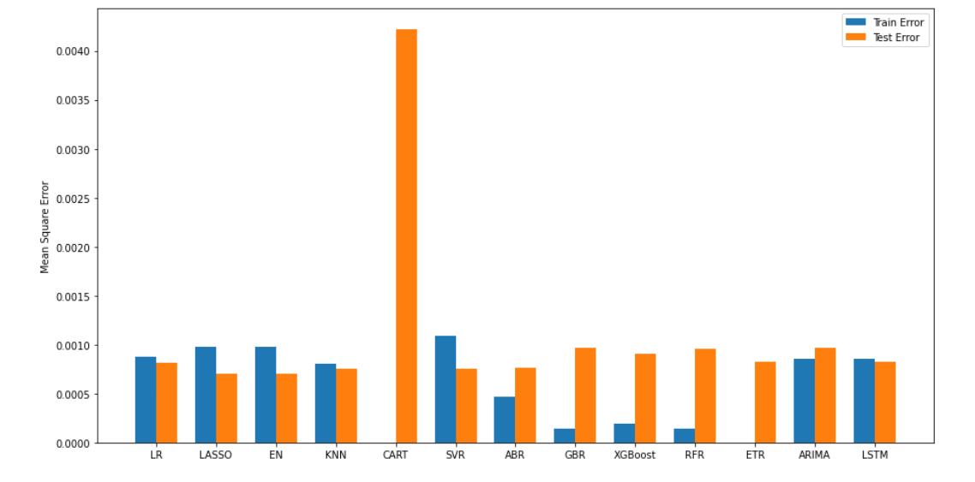
Algorithm Comparisons
However, XGBoost has the same problem as other boosting methods. All boosting method has low train error but high test error. Overfitting problem exits in these models and should be avoided.
Ensemble models, such as gradient boosting regression (GBR) and random forest regression (RFR) have low bias but high variance.
Looking at the training and test errors, our new dataset illustrate different results from the original program: The LSTM model performs decently, which beats the ARIMA model in the test set. Hence, we select the LSTM model for the model tuning.

Slide 15
Model Tuning
Gridsearch is added to tune and find the optimal hyper-paramters of the LSTM model
This includes:
Number of neurons
Learning rate
Number of epochs
Batch Size
Optimizer
Regularizer
For the optimizer, we’ve tried SGD, RMSprop, Adagrad, Adadelta, Adam, Adamax, and Nadam
All combinations of hyperparameters are passed as parameters to the LSTM model to train and predict the data.
The best model is returned. Then it is used to fit and predict the data.
MSE is calculated based on the tuned model

Slide 16
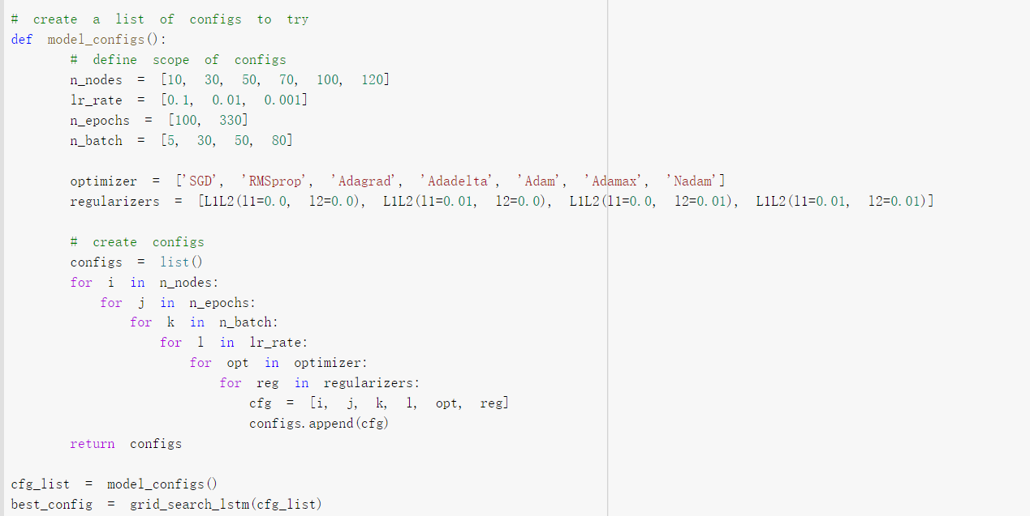
Model Tuning
Time complexity of the first draft is too high, because the number of combinations of all the hyperparameters for tuning is extremely large. We need to improve the algorithm on hyperparameter tuning to reduce the running time.

Slide 17
Model Tuning
In our final version of hyperparameter tuning, we separate process into two steps to reduce the total runtime.
In the first step, we fix the all the hyperparameters except optimizer and regularizer. This would allow us to find the best optimizer and regularizer of this hyperparameter setting.
In the second step, we use the tuned optimizer and regularizer from the first step to tune the remaining hyperparameters.
The total running is reduced in a large extent, from more than 2 hours to only 30 minutes.
It turns out that the best configuration is optimizer=Adamax, regularizer l1=0.01, Number of neurons =120, number of epochs=50, batch size=5, learning rate=0.001.
We first tried fit our data using above configuration, the test results seemed to be pretty good: The MSE on test set decreased from 0.00081 to 0.00069. However, when we visualize the predictions, the predicted cumulation return we obtain had very small fluctuation compared to the actual data. We realized that this might because l1 regularizer is too strict in the grid search. Using L1 limit the scale of weight towards zero, causing predicted power impaired, and we ended up with a mild results.

Slide 18
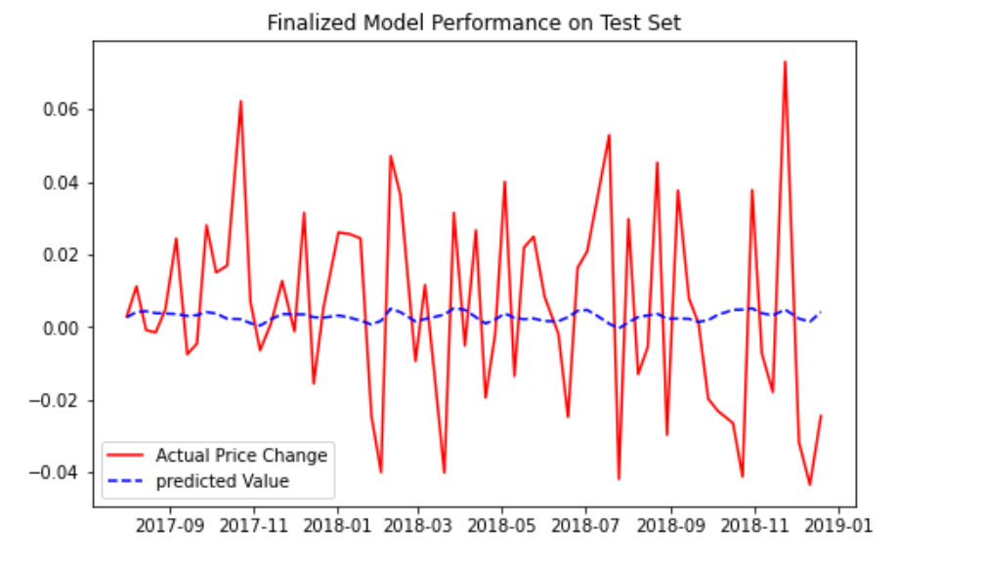
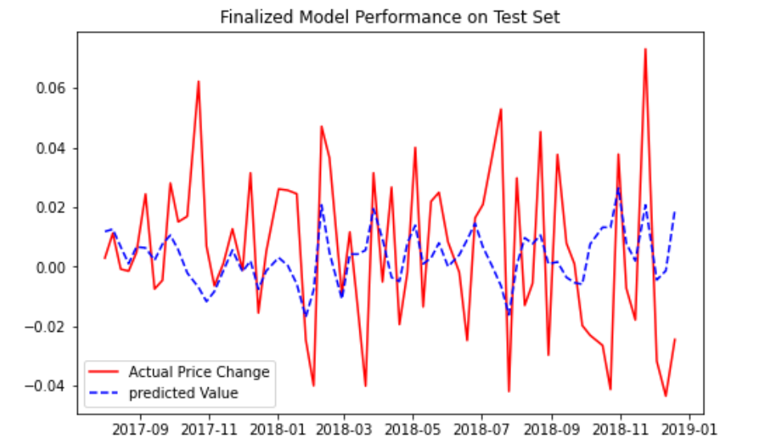
Model Tuning
So we banned l1 regularizer in model tuning, and the predicting power of the new LSTM model turned out to be better.
Using l1 regularizer
Using l2 regularizer

Slide 19
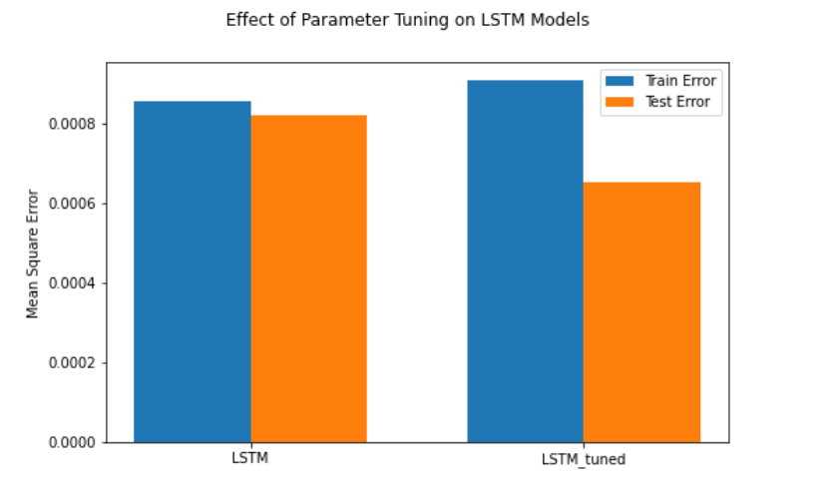
Model Tuning
The diagram below shows the performance of the LSTM model before and after tuning the hyperparameters. We observe that test error are greatly reduced after tuning the hyperparameters. We take this tuned model as our final model.
The configuration of this model is: optimizer='RMSprop', regularizer l2=0.01, Number of neurons =100, number of epochs=100, batch size=80, learning rate=0.001.
Mean squared error on test data is 0.00067.

Slide 20
Evaluation metrics
We calculated some evaluation metrics to measure the performance of the system
This includes financial metrics such as CAGR, Sharpe Ratio, Maximum Draw Down, and Calmar Ratio.
The result of theses metrics are shown below.
Compound annual growth rate on test set achieve 33% return on our trading system.
Sharpe ratio is 1.83, which is greater than 1.0 indicating a high degree of expected return for a relatively low amount of risk

Slide 21
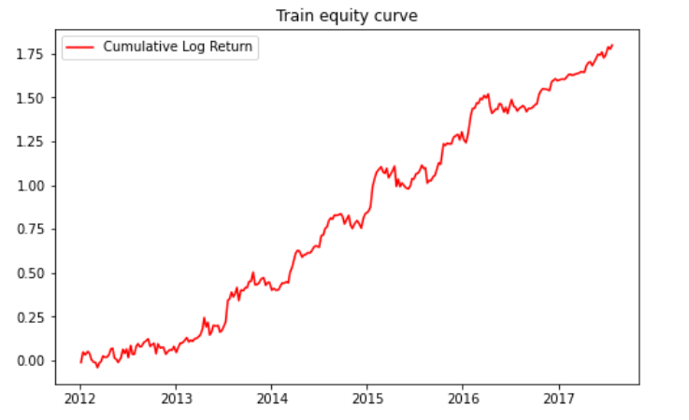
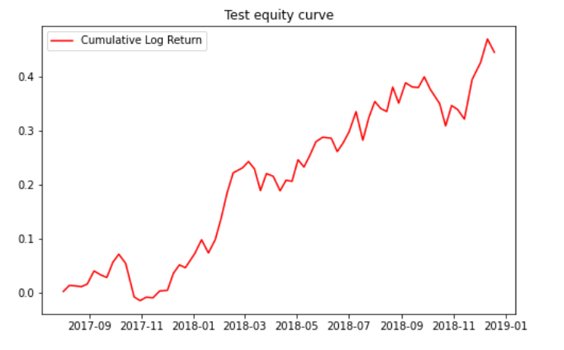
Equity Curves
We plot the train and test equity curve based on cumulative log return on both training and test set.
The result is shown below.

Slide 22
PART 04
Conclusion and Reflection

Slide 23
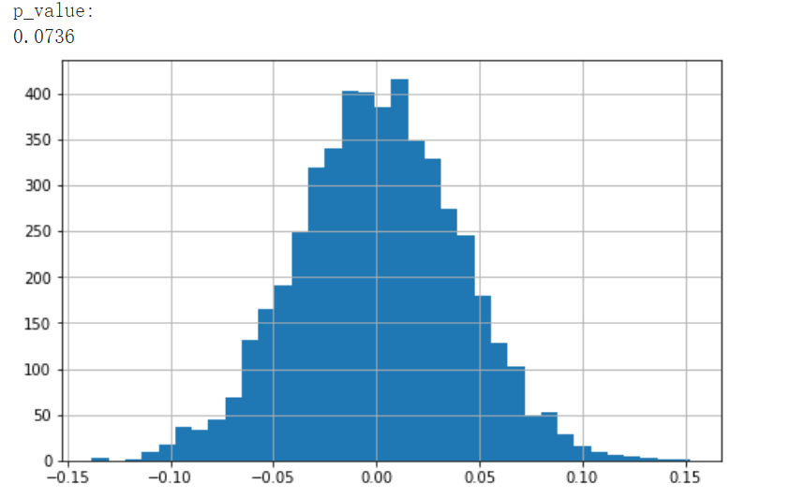
White’s Reality Check
We perform White’s Reality Check using detrended price data
The results is shown below:
The p-value is 0.0736, statistically significant at 10% significance level.
We reject the null hypothesis that our system's return is zero.
Indicating that our algorithm has ability to predict the Microsoft stock price.

Slide 24
Potential Bias and Possible Improvements on our program
Data Leakage problem
The test set is used when tuning and selecting optimal model in our program, which might making our results over optimistic.
The information from unseen data should be set aside in the training process, and should be only used when making predictions based on finalized model.
Model from information leakage may do well on that particular data even if it can't generalize to new data.
We should create validation set for training process, and only use test set when testing model’s ability to properly adapt to unseen data.

Slide 25
THANKS FOR WATCHING

